Slide 1
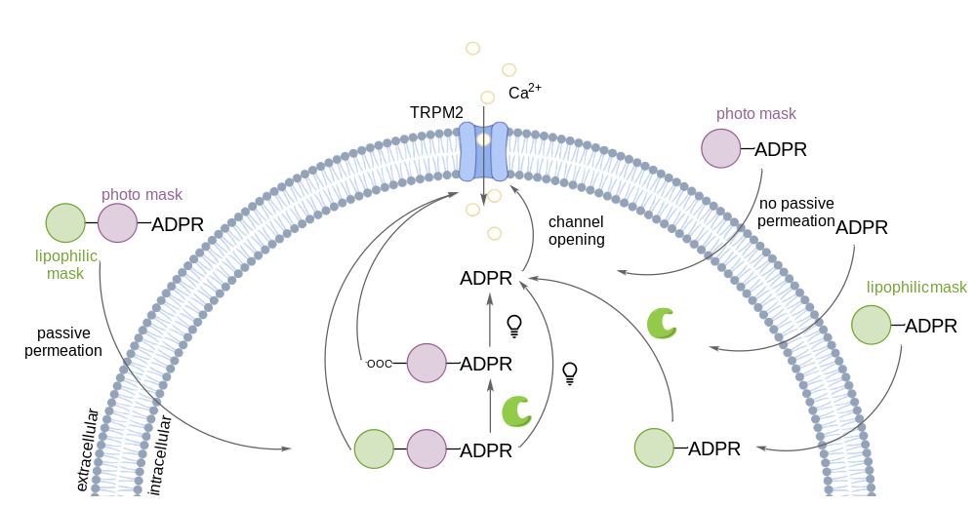
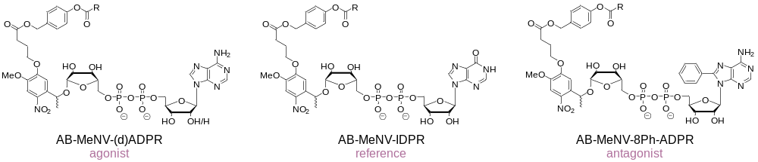
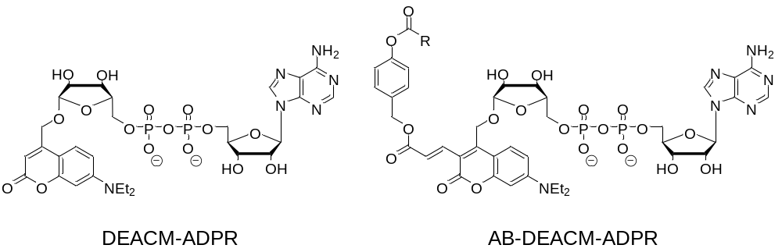
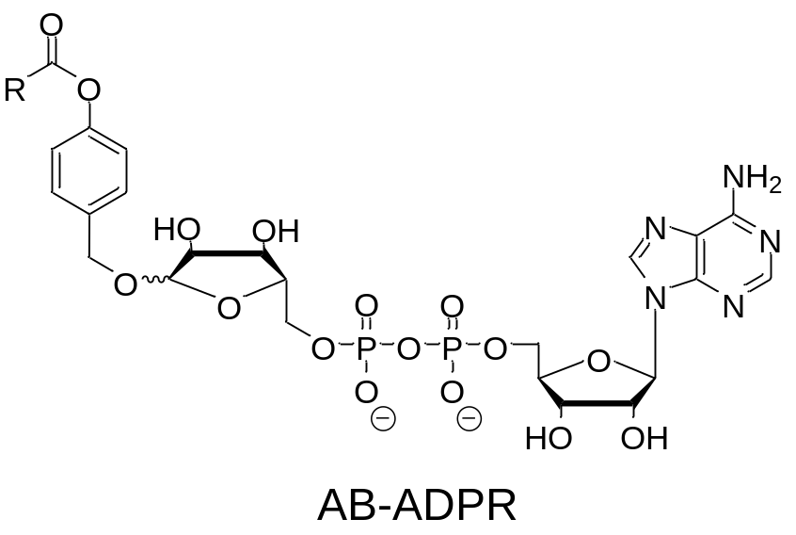
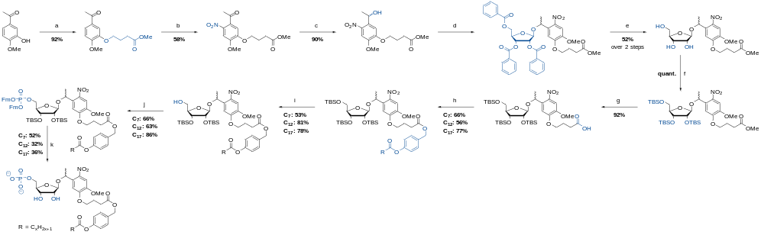
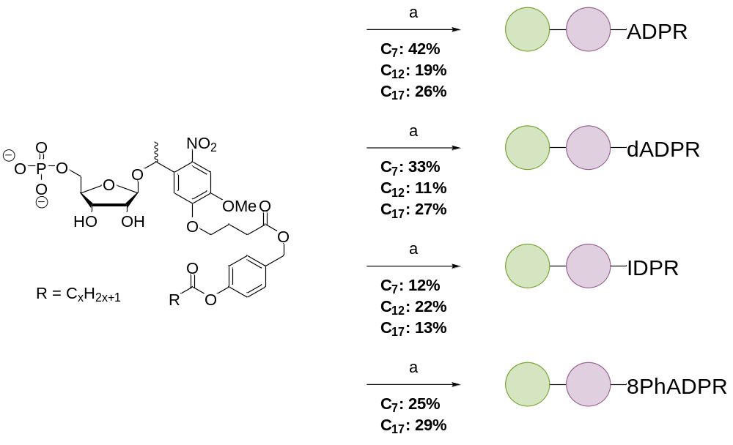
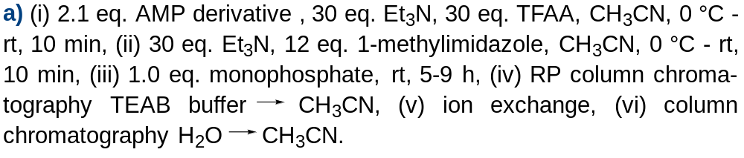
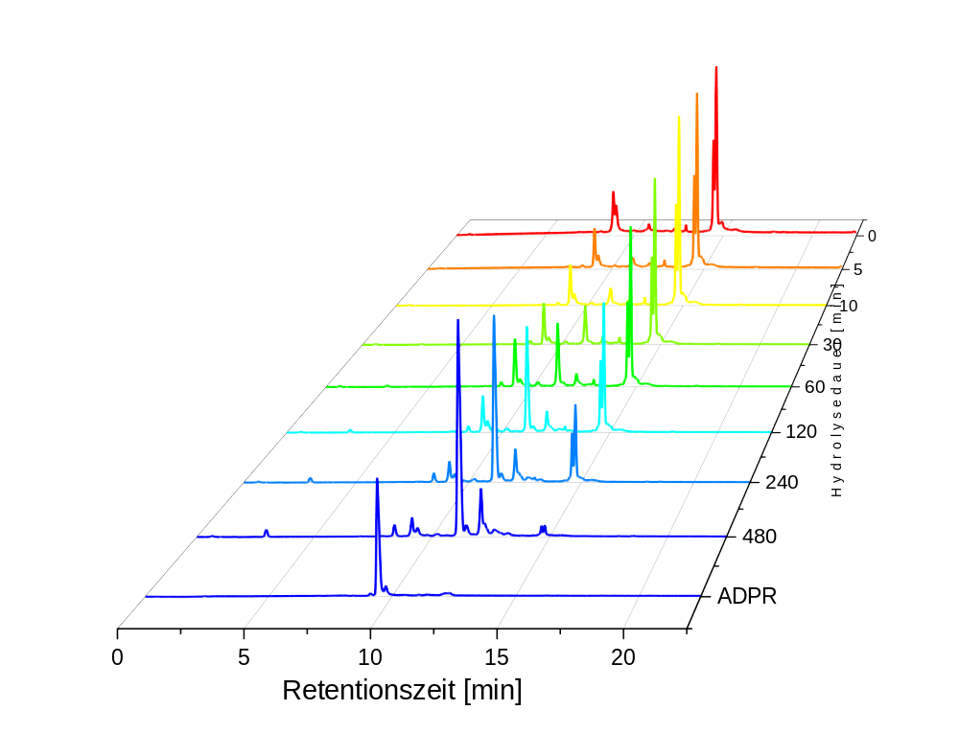
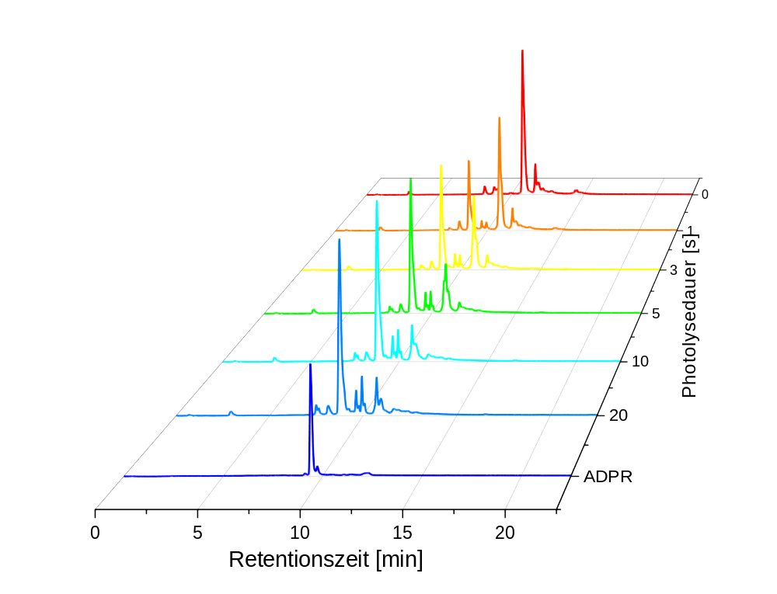
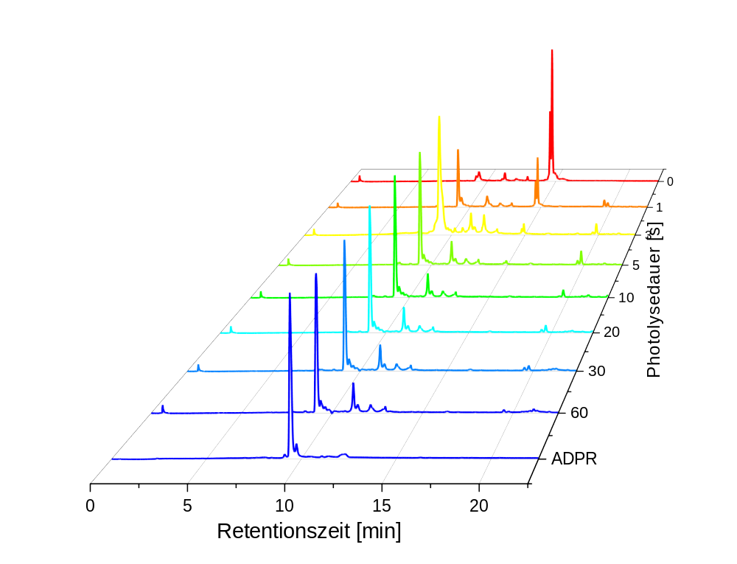
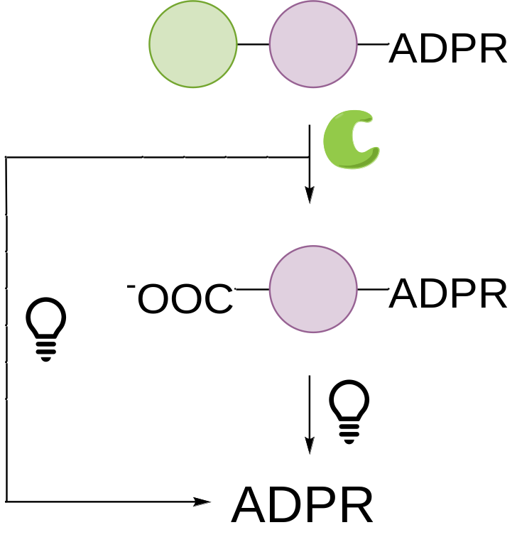
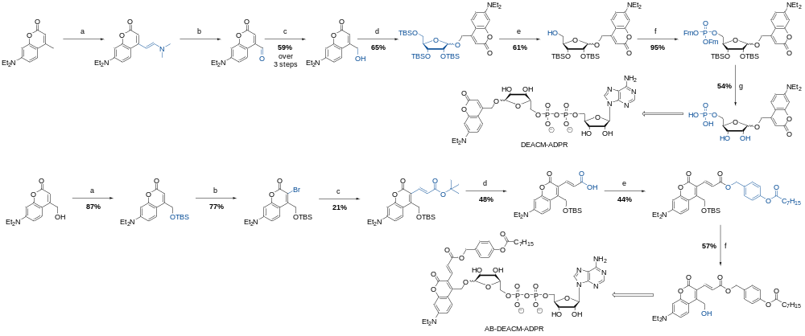
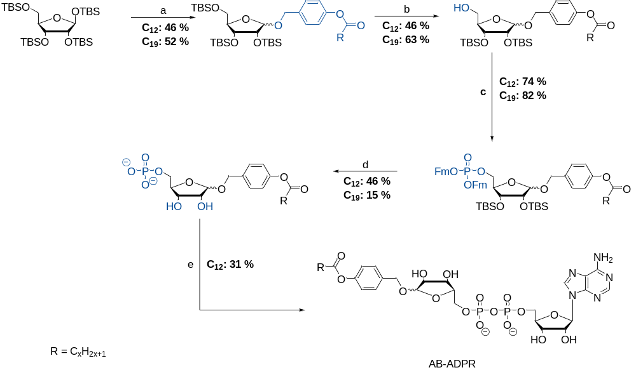
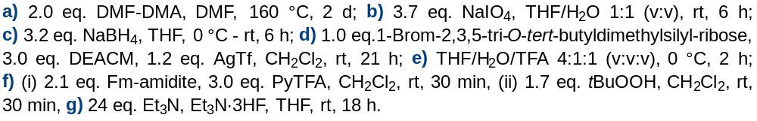
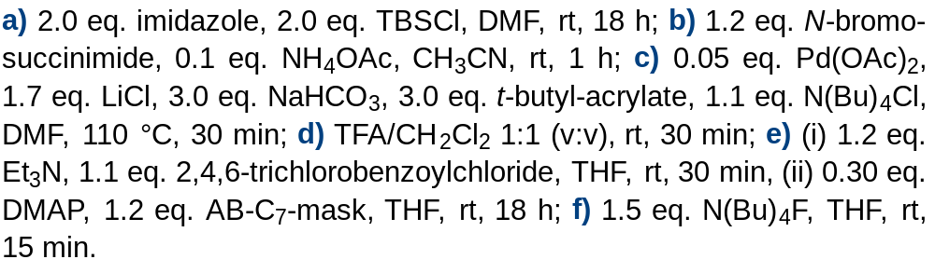
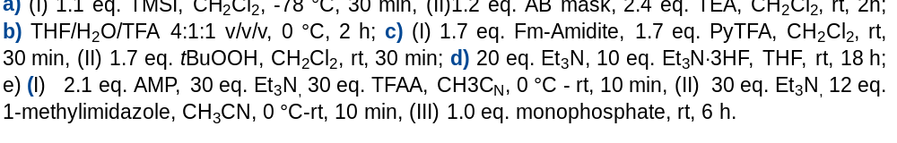
Enzyme-Cleavable and
Photocaged (d)ADPR Derivatives
Celine Fischer and Chris Meier
Organic Chemistry, Department of Chemistry, Faculty of Sciences, University of Hamburg, Martin-Luther-King-Platz 6, 20146 Hamburg, Germany.
Investigation of Transient Receptor Potential Melastatin 2
Lipophilic Masked Photocaged ADPR Derivatives
TRPM2 converts oxidative stress into Ca²⁺ signaling regulating immune activation, inflammation and cell death. TRPM2 is a pharmacological target, and investigating this protein may identify novel therapeutic strategies.
x
x
x
Synthesis of AB-MeNV-Ribose-Monophosphates
Synthesis of AB-MeNV-ADPR Derivatives
Hydrolysis and Photolysis Studies of C7AB-MeNV-ADPR
1
Enzymatic hydrolysis (reaction product (RP))
2
Photolytical release of ADPR from the hydrolysis reaction product (RP) 1
3
Photolytical release of ADPR from the
AB-caged-ADPR
AB-MeNV-ADPR
Hydrolysis-RP
AB-MeNV-ADPR
Hydrolysis-RP
1
ADPR
hydrolysis time [min]
ADPR
photolysis time [s]
ADPR
photolysis time [s]
3
2
retention time [min]
retention time [min]
retention time [min]
retention time [min]
Synthesis of AB-ADPR
Synthesis of (AB-)Coumarin-ADPR
Acknowledgement
References
This study was supported by the Deutsche Forschungsgemeinschaft (DFG)
Project-ID: 335447717 – SFB 1328 (Project A04)
T. E. Storr et al., Tetrahedron 2008, 64, 6125-6137. | M. Yoshikawa, T. Kato, T. Takenishi, Bull. Chem. Soc. Jpn. 1969, 42, 3505-3508. | T. Weinrich et al., Eur. J. Org. Chem. 2017, 3, 491-496. | G. E. Hilbert, T. B. Johnson, J. Am. Chem. Soc. 1930, 52, 4489-94. | K. Mori, M. Takigawa, M. Matsui, Synthesis, 1973, 12, 790-791. | J. P. Olson, et al., J. Am. Chem. Soc. 2013, 135, (16), 5954-5957.

